Slide 1

Organisational Behaviour: A Complete Guide
A comprehensive, illustrated reference for students and curious learners — exploring every major theory across the three levels of analysis: Individual, Group, and Organisational. Every theory in this guide is taught through two lenses: the life you are already living — with friends, family, and daily routines — and the organisational world you are preparing to enter. You don't need work experience to understand these ideas. You just need to look at what's already happening around you.
STUDENT RESOURCE
ORGANISATIONAL BEHAVIOUR

Slide 2

What Is Organisational Behaviour?
The Study of Human Behaviour at Work
Three Levels of Analysis
Organisational Behaviour (OB) is the systematic study of how individuals, groups, and structures affect and are affected by behaviour within organisations. It draws on psychology, sociology, anthropology, and management science to explain why people act the way they do at work — and how managers can harness that understanding to build more effective, humane, and productive workplaces.
1
Individual (Micro OB)
Personality, motivation, perception, learning, and attitudes — the building blocks of behaviour.
OB is not just academic theory. It is a practical toolkit that helps leaders motivate teams, resolve conflict, design better organisations, and manage change — all by understanding the human element at the core of every enterprise.
2
Group (Meso OB)
Leadership, teamwork, communication, conflict, and power dynamics between people.
3
Organisational (Macro OB)
Structure, culture, change management, and systems that shape the entire organisation.
💡 A Note on How to Read This Guide
You don't need to have worked in an organisation to understand Organisational Behaviour. Every theory in this guide plays out first in the places you already know — your family home, your friend group, your school, your sports team, your WhatsApp group. The videos and examples in this guide are designed to meet you there first, so that when you do enter the workplace, you'll recognise what's happening because you've already lived a version of it.

Slide 3





Foundational OB Models
Before exploring the three levels, it is essential to understand the philosophical frameworks that underpin how organisations choose to manage human behaviour. These models represent an evolution in managerial thinking — from raw authority to a genuine recognition of human worth.
📹 Video Placeholder — "Think about how decisions get made in your family. Does one parent just say 'because I said so' — or do you all sit down and talk it through? Does your household run on rules and routines, or on trust and teamwork? This video maps those exact family and friendship dynamics onto the four OB management models — Autocratic, Custodial, Supportive, and Collegial — so you can see which model you've been living inside before you ever set foot in an office."
Autocratic
Custodial
Supportive
Collegial
Based on power and authority. Managers command; employees comply. Dependency on the boss is high, and employee needs for subsistence are barely met. Effective in crises but damaging to morale over time.
Focuses on economic security — salaries, benefits, and welfare programmes. Employees become dependent on the organisation rather than the individual manager. Loyalty increases but not necessarily performance.
Emphasises managerial support and employee participation. Managers help employees achieve their goals. Employees feel a sense of participation and task involvement, driving motivation beyond basic compliance.
Teamwork and shared responsibility define this model. Managers act as partners rather than bosses. Employees develop self-discipline and feel responsible for their work, fostering a culture of mutual trust.
Human Value Model
Contingency Model
Prioritises the intrinsic worth and potential of every employee. Organisations invest in growth, dignity, and meaningful work. Employees are seen as ends in themselves, not merely means to organisational goals.
Asserts there is no single best management style. The ideal approach depends on the situation — the task, the team, the environment. Leaders must be adaptive and contextually intelligent.
Theory Z
Developed by William Ouchi, Theory Z integrates the best of Japanese and American management practices. It champions long-term employment, consensual and collective decision-making, slow evaluation and promotion, holistic concern for employees (including their families), and a blend of formal structure with informal controls. It bridges culture and management philosophy in a powerful way.

Slide 4



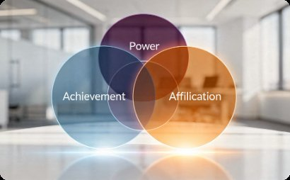
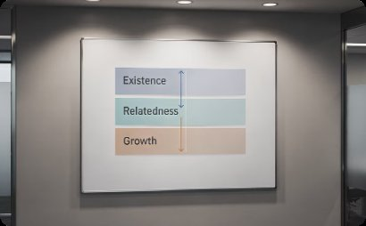
LEVEL 1 — INDIVIDUAL
Motivation: Content Theories
Content theories of motivation ask "What motivates people?" — they identify the internal needs and drives that energise human behaviour at work. Understanding these theories helps managers design roles and rewards that genuinely fulfil employee needs.
📹 Video Placeholder — "Why do you push through a late-night study session for something you actually care about, but can't drag yourself to start an assignment you don't? Why does a 'well done' from someone you respect feel better than a cash reward? Why do you need to belong to a group before you can focus on achieving anything? This video walks through Maslow, Herzberg, McClelland and Alderfer using the real motivation patterns from your daily life — revision, friendships, family approval, personal goals — before showing you exactly how the same forces operate in every workplace you'll ever enter."
Maslow's Hierarchy of Needs
Herzberg's Two-Factor Theory
McClelland's Achievement Motivation
Alderfer's ERG Theory
Abraham Maslow proposed that human needs form a five-level pyramid: Physiological → Safety → Social → Esteem → Self-Actualisation. People are motivated to satisfy lower-level needs first before ascending to higher-level ones. In the workplace, this means pay and job security matter before recognition and personal growth.
Frederick Herzberg distinguished between Hygiene Factors (salary, working conditions, company policy — whose absence causes dissatisfaction) and Motivators (achievement, recognition, growth — whose presence creates true satisfaction). Crucially, removing dissatisfiers does not automatically motivate — you must actively provide motivators.
Clayton Alderfer condensed Maslow's five levels into three: Existence (physiological and safety), Relatedness (social and esteem from others), and Growth (self-esteem and self-actualisation). Unlike Maslow, Alderfer acknowledged that multiple needs can operate simultaneously, and frustration at a higher level can cause regression to a lower one.
David McClelland identified three dominant needs: Need for Achievement (nAch) — the drive to excel and accomplish; Need for Affiliation (nAff) — the desire for close relationships; and Need for Power (nPow) — the need to influence others. High achievers prefer moderate risk, clear feedback, and personal responsibility.

Slide 5




LEVEL 1 — INDIVIDUAL
Motivation: Process Theories
Process theories ask "How does motivation work?" — they examine the cognitive processes and mechanisms through which people become motivated, make decisions, and regulate their behaviour over time.
📹 Video Placeholder — "Why do you stop trying at something the moment the reward feels pointless — even if you were working hard before? Why does it sting so much when a sibling or friend gets praised for the same effort you put in and got nothing for? Why do you actually follow through on goals you set yourself but ignore ones that were handed to you? This video uses those exact moments — from family comparisons to personal goal-setting to the feeling of being treated unfairly — to bring Vroom, Adams, Locke and Skinner to life. By the end, you'll see these processes running in the background of your everyday decisions, long before they ever show up in a performance review."
Vroom's Expectancy Theory
Adams' Equity Theory
Victor Vroom argued that motivation is a product of three beliefs: Expectancy (if I try hard, will I perform well?), Instrumentality (if I perform well, will I be rewarded?), and Valence (do I actually value that reward?). Motivation = E × I × V. If any one element equals zero, motivation collapses entirely — making this theory a powerful diagnostic for disengaged employees.
J. Stacy Adams proposed that people assess fairness by comparing their input-to-outcome ratio against a reference person's ratio. When perceived inequity exists — either under-rewarded or over-rewarded — people take action to restore balance: reducing effort, seeking more pay, rationalising the difference, or leaving the organisation. Fairness, not just reward size, drives motivation.
Locke's Goal-Setting Theory
Skinner's Reinforcement Theory
Edwin Locke demonstrated that specific, challenging goals lead to higher performance than vague or easy ones. Effective goals are S.M.A.R.T — Specific, Measurable, Achievable, Relevant, and Time-bound. Commitment to the goal, feedback on progress, and task complexity all moderate its effectiveness. This theory underpins most modern performance management systems.
B.F. Skinner held that behaviour is a function of its consequences. Positive reinforcement (adding a reward) and negative reinforcement (removing an aversive stimulus) increase behaviour. Punishment suppresses it. Extinction (withholding reinforcement) gradually eliminates it. Managers apply this through praise, bonuses, disciplinary procedures, and consistent feedback structures.

Slide 6

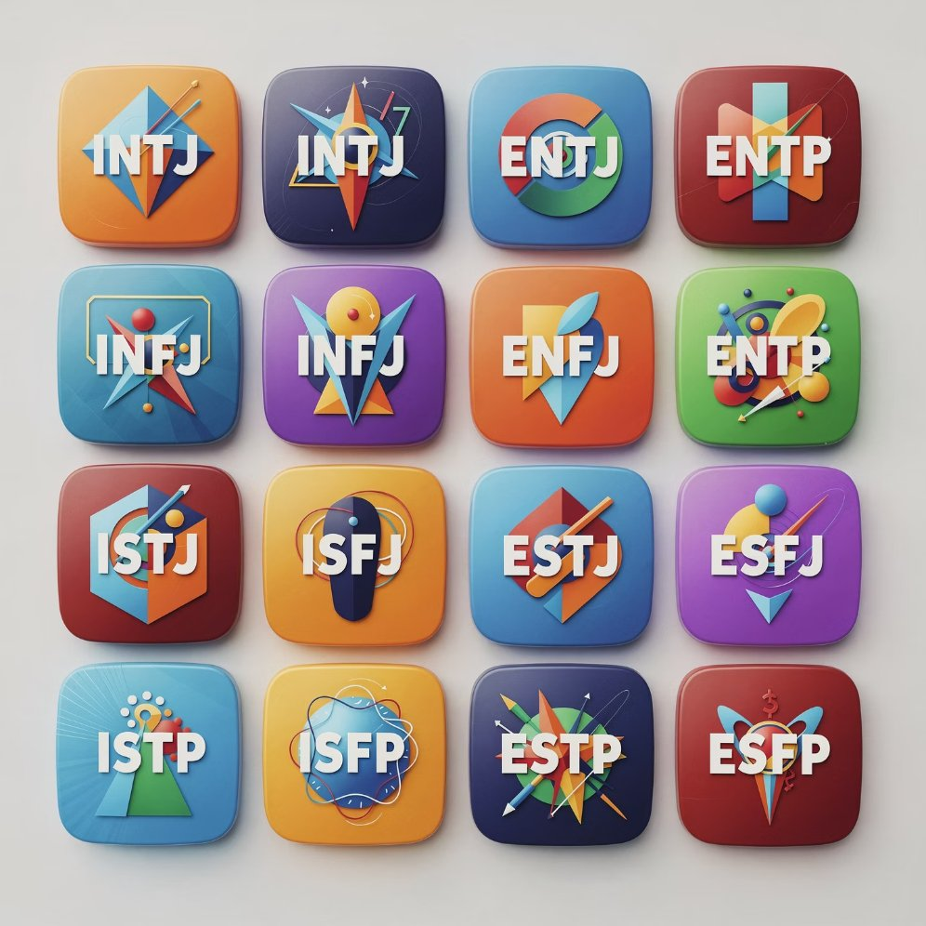
LEVEL 1 — INDIVIDUAL
Personality Theories
Personality refers to a relatively stable set of characteristics, traits, and tendencies that shape how an individual thinks, feels, and behaves. In OB, understanding personality helps predict job performance, inform hiring decisions, and improve team composition.
📹 Video Placeholder — "Are you the one in your friend group who always finishes what they start — or the one who generates all the ideas but loses interest halfway through? Do you recharge by being around people or by being alone? Do you tend to trust easily or stay guarded? You already have a personality — you've been living it your whole life. This video uses your real patterns with friends, family, and school to explain the Big Five, MBTI and Holland's types — so that when you eventually take a personality assessment at work, you'll understand what it's actually measuring and why it matters for how you work with others."
The Big Five Model (OCEAN)
Myers-Briggs Type Indicator (MBTI)
The most empirically supported personality framework identifies five dimensions: Openness (creativity, curiosity, openness to experience), Conscientiousness (reliability, organisation, self-discipline), Extraversion (sociability, assertiveness, positive emotionality), Agreeableness (cooperation, trust, empathy), and Neuroticism (emotional instability, anxiety, moodiness). High conscientiousness consistently predicts job performance across roles and industries.
Based on Carl Jung's typology, the MBTI classifies individuals across four dichotomies: Extraversion/Introversion, Sensing/Intuition, Thinking/Feeling, and Judging/Perceiving. This produces 16 personality types (e.g., INTJ, ENFP). Widely used in team-building and coaching, though its scientific reliability is debated — it is best used as a self-reflection tool rather than a definitive predictor.
Holland's Typology of Personality–Job Fit
John Holland proposed six personality types — Realistic, Investigative, Artistic, Social, Enterprising, and Conventional (RIASEC) — each corresponding to ideal job environments. Person–environment congruence (the match between personality and job type) predicts greater job satisfaction, commitment, and lower turnover. Holland's hexagonal model shows how similar or dissimilar types are to each other.

Slide 7
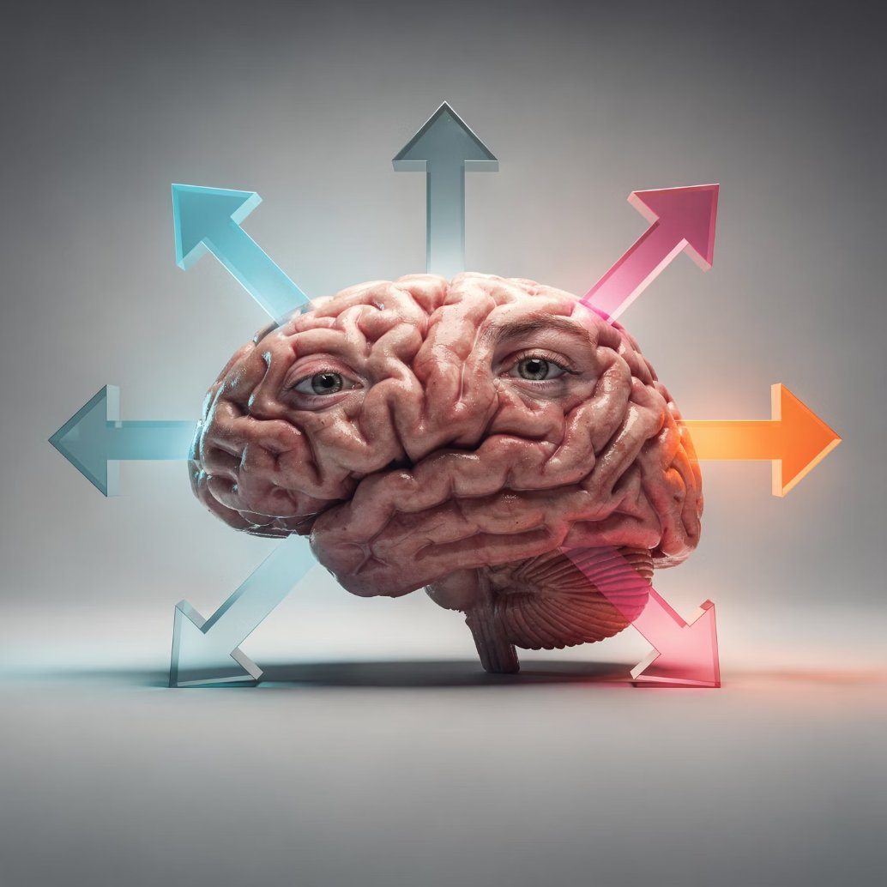

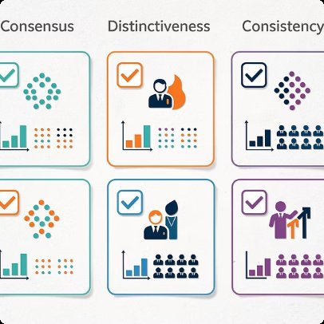

LEVEL 1 — INDIVIDUAL
Perception & Attribution
Perception is the process by which individuals select, organise, and interpret sensory information to give meaning to their environment. Because people's perceptions differ, the same event can produce entirely different behavioural responses — making perception a critical concept in OB.
📹 Video Placeholder — "Have you ever immediately assumed someone was being rude — then found out they were just having a terrible day? Have you ever judged a new person in your class within seconds of meeting them, based on almost nothing? Have you ever blamed a bad grade on the exam being unfair, but assumed someone else failed because they didn't study? That's Attribution Theory, the Halo Effect, and Self-Serving Bias — playing out in your daily life right now. This video unpacks perception and attribution through the snap judgements you make about friends, family, and strangers every single day — so you can spot these biases in yourself before they damage your relationships at work and beyond."
Attribution Theory (Heider)
Kelley's Covariation Model
Social Perception Theory
Fritz Heider's theory explains how people interpret the causes of behaviour — either internally (dispositional: the person's ability, personality, or effort) or externally (situational: luck, task difficulty, or environment). Misattribution leads to biases such as the Fundamental Attribution Error (over-attributing others' failures to character) and Self-Serving Bias (claiming credit for success, blaming circumstances for failure).
Harold Kelley refined attribution theory by identifying three criteria people use when attributing cause: Consensus (do others behave the same way?), Distinctiveness (does this person behave differently in other situations?), and Consistency (does this happen every time?). High consensus + high distinctiveness + high consistency → external attribution. Low on all three → internal attribution.
Social perception examines how we form impressions of other people. Key distortions include: Stereotyping (judging by group membership), Halo Effect (one positive trait colours the whole impression), Selective Perception (filtering information to confirm existing beliefs), and Projection (attributing one's own traits to others). These biases profoundly affect hiring, appraisals, and workplace relationships.

Slide 8


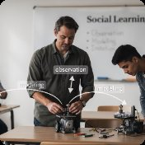
LEVEL 1 — INDIVIDUAL
Learning Theories & Attitudes
Learning refers to any relatively permanent change in behaviour that occurs as a result of experience. Understanding how people learn enables managers to design effective training, onboarding, and behaviour-change programmes.
📹 Video Placeholder — "Why do you feel anxious before a family event that's always gone badly — even when this time might be different? Why did you pick up your parents' habits without ever being taught them? Why do you feel uncomfortable when you act against your own values — even when no one else knows? Pavlov, Skinner, Bandura and Festinger are all running in the background of your daily life: in the routines you've absorbed from home, the role models you've unconsciously copied, and the inner tension you feel when your actions don't match your beliefs. This video makes those invisible learning processes visible — so you understand not just how organisations train people, but how you yourself were shaped long before you ever entered one."
Classical Conditioning (Pavlov)
Operant Conditioning (Skinner)
Social Learning Theory (Bandura)
Ivan Pavlov demonstrated that a neutral stimulus (a bell) could elicit a response (salivation) when repeatedly paired with an unconditioned stimulus (food). In OB, this explains how employees may develop emotional associations — anxiety before a performance review, enthusiasm at a familiar team ritual — through repeated pairing of stimuli with organisational events.
B.F. Skinner showed that voluntary behaviours are shaped by their consequences. Behaviour followed by a positive outcome is strengthened; behaviour followed by a negative outcome is weakened. Organisations use schedules of reinforcement — continuous or intermittent — to shape employee performance, punctuality, safety behaviours, and customer service standards.
Albert Bandura argued that people learn by observing others, not just through direct experience. Four processes mediate this: Attention (noticing the behaviour), Retention (remembering it), Reproduction (being able to replicate it), and Motivation (wanting to do so). Mentorship programmes, role modelling by leaders, and peer learning all rely on this theory.
Cognitive Dissonance Theory (Festinger)
Rokeach Value Survey
Leon Festinger proposed that people experience psychological discomfort — dissonance — when their attitudes and behaviours conflict. To reduce this discomfort, they change their attitude, change their behaviour, or rationalise the inconsistency. In OB, this explains resistance to change, post-purchase regret, and employees' internal justifications for unethical acts.
Milton Rokeach distinguished between Terminal Values (desirable end-states: happiness, freedom, equality) and Instrumental Values (desirable modes of behaviour: honesty, ambition, courage). Understanding employee values helps organisations align culture, reward systems, and leadership approaches with what people truly care about at the deepest level.

Slide 9




LEVEL 1 — INDIVIDUAL
Ethics in Organisational Behaviour
Ethics in OB examines the moral principles and values that guide individual and organisational decision-making. Understanding ethical frameworks helps us recognise why people do the right — or wrong — thing at work, and how organisations can build cultures where integrity is the default, not the exception.
📹 Video Placeholder — "Have you ever stayed quiet when you saw something unfair happen to a friend — because everyone else stayed quiet too? Have you ever done something you knew was wrong and told yourself 'it's not a big deal' or 'everyone does it'? Have you ever felt genuinely torn between what was right and what was easy? Ethics isn't something that only happens in boardrooms and corporate scandals. It happens in your group chat, your family dinner, your school corridor, every single day. This video uses those real moral moments from your personal life to explain Kohlberg's stages, Kant's Categorical Imperative, and Bandura's moral disengagement — so you understand not just what ethical theory says, but why good people — people just like you — sometimes fail to act on it."
Kohlberg's Stages of Moral Development
Utilitarianism (Bentham & Mill)
Deontological Ethics (Kant)
Stakeholder Theory (Freeman)
Lawrence Kohlberg proposed that moral reasoning develops through three levels and six stages. Pre-conventional (Stages 1–2): morality is driven by self-interest — avoiding punishment and seeking reward. Conventional (Stages 3–4): morality is defined by social norms, rules, and the expectations of others. Post-conventional (Stages 5–6): morality is guided by universal principles and personal conscience, even when they conflict with law or authority. In OB, most adults operate at the conventional level — which explains why organisational culture and peer norms are such powerful drivers of ethical (and unethical) behaviour.
Utilitarian ethics holds that the morally right action is the one that produces the greatest good for the greatest number. In organisational decisions — redundancies, resource allocation, policy design — managers often implicitly apply utilitarian reasoning. Its strength is its focus on outcomes and collective welfare. Its weakness: it can justify harm to minorities if the aggregate benefit is large enough. Managers must be alert to whose interests are being counted — and whose are being ignored.
Immanuel Kant's deontological ethics holds that certain actions are intrinsically right or wrong, regardless of their consequences. His Categorical Imperative offers two key tests: (1) Act only according to principles you could will to become universal laws — would it be acceptable if everyone did this? (2) Treat people as ends in themselves, never merely as means — are you using people instrumentally? In OB, deontological thinking underpins codes of conduct, whistleblowing protections, and the principle that employees have rights that cannot be traded away for organisational gain.
R. Edward Freeman's Stakeholder Theory argues that organisations have ethical obligations not just to shareholders, but to all parties affected by their decisions — employees, customers, suppliers, communities, and the environment. Ethical management requires identifying stakeholders, understanding their interests, and balancing competing claims fairly. This theory directly challenges the shareholder-primacy model and has become the foundation of Corporate Social Responsibility (CSR), ESG frameworks, and modern business ethics curricula.
Ethical Decision-Making Frameworks
Why Good People Do Bad Things
Rest's Four-Component Model: James Rest proposed that ethical action requires four components: (1) Moral Sensitivity — recognising that a situation has ethical dimensions; (2) Moral Judgement — determining what is right; (3) Moral Motivation — prioritising ethical values over personal interests; (4) Moral Character — having the willpower to follow through. Failure at any stage explains why people who "know better" still act unethically.
🧠 Ethical Fading & Moral Disengagement Albert Bandura's concept of moral disengagement explains how people disengage their ethical standards through mechanisms like: moral justification ("it's for a greater good"), euphemistic labelling ("restructuring" instead of "firing"), displacement of responsibility ("I was just following orders"), and dehumanisation (treating others as less than human). Ethical fading (Tenbrunsel & Messick) describes how the ethical dimensions of a decision gradually fade from awareness — replaced by financial, legal, or strategic framing — until people no longer see the moral choice in front of them. These concepts explain corporate scandals, institutional abuse, and everyday workplace wrongdoing.
Ethical Climate Theory (Victor & Cullen): The ethical climate of an organisation — the shared perceptions of what is ethically correct and how ethical issues should be handled — powerfully shapes individual behaviour. Climates can be egoistic (self-interest), benevolent (concern for others), or principled (rules and codes). Leaders set the climate through their own behaviour, the systems they design, and the behaviours they reward or ignore.

Slide 10

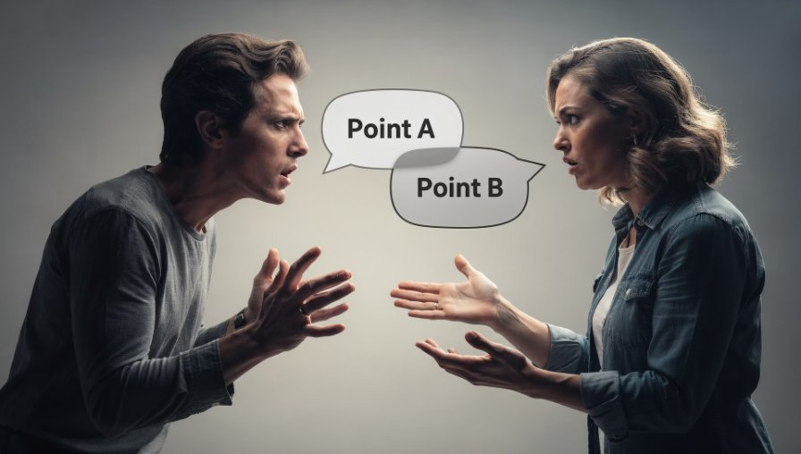



LEVEL 2 — GROUP
Group Dynamics & Teamwork
Group dynamics explores how people interact, influence each other, and develop shared norms and identities within teams. Understanding these dynamics is essential for building high-performing, cohesive groups.
📹 Video Placeholder — "Think about the last group of people you were thrown into — a new class, a sports team, a group project, a family gathering with relatives you barely know. There was probably an awkward start, maybe a blow-up at some point, then things settled, and eventually the group either clicked or fell apart. That's Tuckman's model — Forming, Storming, Norming, Performing, Adjourning — and you've lived through it dozens of times already. This video maps those exact social experiences from your personal life onto group dynamics theory, so that when you're placed in a work team for the first time, you'll know exactly which stage you're in — and what to do about it."
1
2
Forming
Members are polite, uncertain, and dependent on the leader for guidance. Goals and roles are unclear.
3
Storming
Conflict emerges as personalities clash and members compete for influence. Leadership may be challenged.
4
Norming
The group establishes shared norms, roles solidify, and cohesion grows. Cooperation replaces conflict.
5
Performing
The group functions as a high-performance unit. Energy is directed toward the task rather than internal dynamics.
Adjourning
The group disbands after completing its task. Members reflect on achievements and may experience loss.
Belbin's Team Roles
Social Identity Theory (Tajfel & Turner)
Meredith Belbin identified nine team roles across three clusters: Action-Oriented (Shaper, Implementer, Completer-Finisher), People-Oriented (Coordinator, Teamworker, Resource Investigator), and Thought-Oriented (Plant, Monitor-Evaluator, Specialist). Effective teams balance these roles. Knowing your role allows you to contribute your strengths while compensating for team gaps.
People derive part of their self-concept from membership in social groups — including work teams and organisations. In-group favouritism and out-group discrimination emerge naturally from this. Managers must leverage shared identity to build cohesion while actively countering inter-group bias that fragments organisational collaboration.

Slide 11

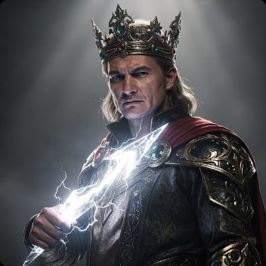
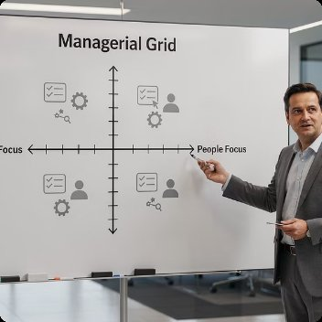


LEVEL 2 — GROUP
Leadership Theories
Leadership is one of the most studied topics in OB. Theories have evolved from viewing leadership as an innate trait to recognising it as a dynamic, relational, and context-dependent process. Below is a structured overview of each theoretical generation.
📹 Video Placeholder — "Think about the people in your life who have led you — a parent, a coach, a teacher, an older sibling, a friend who always takes charge. What made you actually follow them? Was it their title, their personality, their knowledge, or the way they made you feel? And think about the ones who had authority but lost your respect — why? Leadership theory isn't just about CEOs. It's about every person who has ever influenced your behaviour. This video uses the leaders already in your life to walk through Trait, Behavioural, Contingency and Transformational theories — so you understand leadership as something you've already experienced, evaluated, and responded to your whole life."
Trait Theories
Behavioural Theories
Contingency Theories
Contemporary Theories
The "Great Man" Theory assumed leaders were born, not made — possessing innate qualities like charisma, intelligence, and determination. Later trait research identified specific characteristics (drive, integrity, self-confidence, emotional intelligence) that distinguish effective leaders. Limitation: traits alone don't account for situational variation.
The Ohio State Studies identified two key dimensions: Initiating Structure (task focus) and Consideration (people focus). The University of Michigan Studies produced similar findings. Blake & Mouton's Managerial Grid plots concern for people against concern for production, identifying five leadership styles, with "Team Management" (9,9) as ideal.
Fiedler's Contingency Model argues leadership effectiveness depends on matching leader style (task vs. relationship-oriented) to situational favourableness. Path-Goal Theory (House) holds that leaders should adapt style (directive, supportive, participative, achievement-oriented) to remove obstacles and motivate followers. Hersey-Blanchard Situational Leadership matches style to follower maturity and readiness.
Transformational Leadership inspires change through vision, charisma, and intellectual stimulation. Transactional Leadership manages through contingent rewards and exception-based monitoring. Leader-Member Exchange (LMX) explores the quality of dyadic relationships between leaders and followers, noting that "in-group" members receive more resources. Servant Leadership places follower needs first, building community and shared purpose.

Slide 12
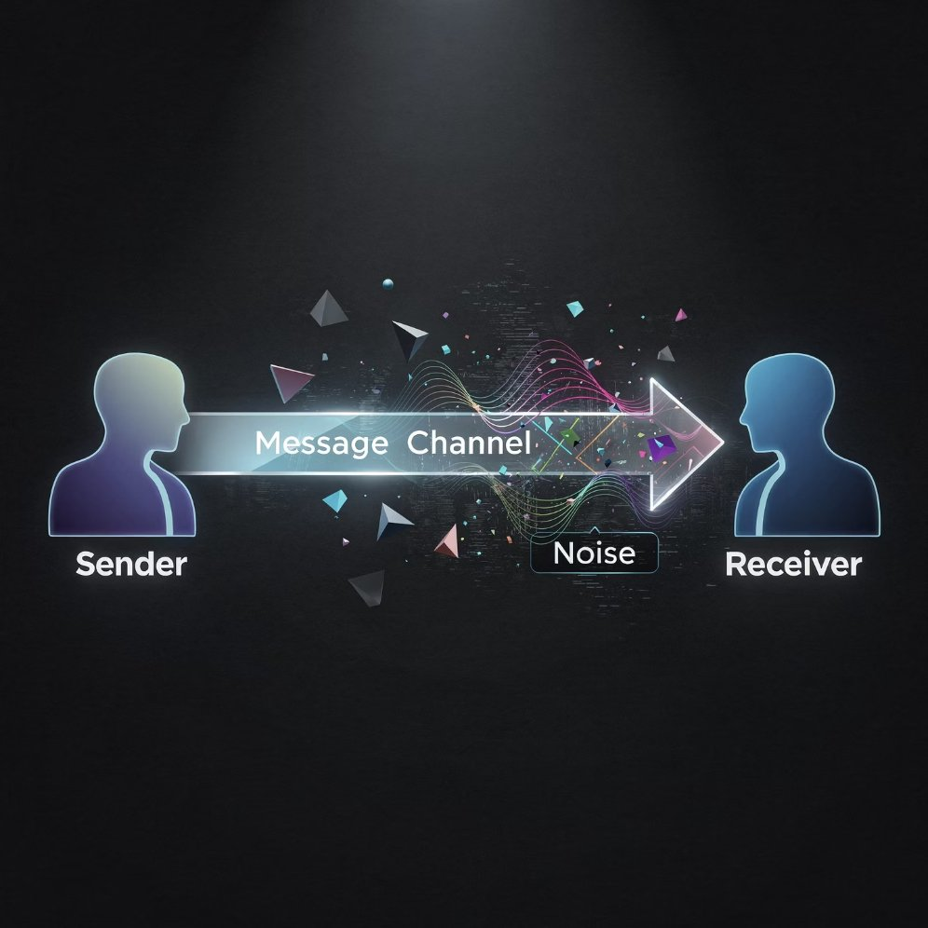





LEVEL 2 — GROUP
Power, Politics & Communication
French & Raven's Five Bases of Power
Communication Theories
John French and Bertram Raven identified five distinct sources from which leaders and others draw their power in organisations. Understanding these bases helps both leaders exercise influence effectively and employees recognise how power operates around them.
The Shannon-Weaver Model depicts communication as a linear process: a sender encodes a message, transmits it through a channel, and a receiver decodes it — all subject to noise that distorts meaning. While simplified, it highlights that breakdowns can occur at every stage. Interpersonal Communication Styles (assertive, aggressive, passive, passive-aggressive) further shape how messages land and relationships develop.
Legitimate Power
Derived from formal position or role in the organisational hierarchy. It is granted by the organisation and is recognised by others as rightful authority.
📹 Video Placeholder — "Who has power over you right now — and why do you actually let them? Is it because they can punish you (coercive)? Because they control something you want (reward)? Because they know more than you (expert)? Because you genuinely admire them (referent)? Or just because of their role (legitimate)? These five power bases aren't just in organisations — they're in your family, your friend group, your school, your social media feed. And communication? Think about the last time a message you sent was completely misunderstood. That's Shannon-Weaver's noise in action. This video decodes power and communication through the relationships you're already navigating every day."
Reward Power
The ability to grant positive outcomes — pay rises, promotions, praise, or preferred assignments — to influence behaviour.
Coercive Power
Based on fear of punishment, demotion, or other negative consequences. Effective in the short term but corrosive to trust and engagement.
Expert Power
Drawn from superior knowledge, skill, or expertise. Highly credible and sustainable, as it is earned through demonstrated competence.
Referent Power
Based on admiration, identification, and liking. Charismatic leaders and trusted mentors hold referent power through relationship quality.

Slide 13





LEVEL 2 — GROUP
Conflict & Negotiation
Conflict is an inevitable part of organisational life. When managed well, it can stimulate creativity and improve decision quality. When managed poorly, it damages relationships and performance. Negotiation is the key process through which conflict is resolved.
📹 Video Placeholder — "Think about how you handle conflict with a sibling, a close friend, or a parent. Do you go in hard and fight for what you want (Competing)? Do you avoid the conversation entirely and hope it goes away (Avoiding)? Do you give in to keep the peace even when you're right (Accommodating)? Or do you sit down and actually work it out together (Collaborating)? You already have a default conflict style — you've been using it your whole life. This video uses those real personal conflicts to map the Thomas-Kilmann model and Fisher & Ury's negotiation principles onto your lived experience — so that when you face conflict at work, you'll know exactly what you're doing and why, and whether it's actually serving you."
Thomas-Kilmann Conflict Mode Instrument (TKI)
Principled Negotiation (Fisher & Ury)
Kenneth Thomas and Ralph Kilmann mapped five conflict-handling styles on two dimensions — Assertiveness (concern for own goals) and Cooperativeness (concern for others' goals):
Developed at Harvard, this approach from Getting to Yes outlines four core principles that move negotiation from positional bargaining to interest-based resolution:
Separate people from the problem — attack the issue, not the individual, preserving relationships.
Focus on interests, not positions — understand the underlying needs driving each party's stance.
Invent options for mutual gain — brainstorm creative solutions before evaluating them.
Insist on objective criteria — use fair standards (market value, legal precedent, expert opinion) to evaluate options.
The concept of BATNA (Best Alternative to a Negotiated Agreement) is central: knowing your walk-away point gives you confidence and prevents accepting a poor deal out of pressure.
Competing
Collaborating
High assertiveness, low cooperation. Win-lose approach. Best for emergencies or when decisiveness is critical.
High on both. Win-win approach. Best for complex problems where full integration of perspectives is needed.
Compromising
Avoiding
Moderate on both. Partial win-partial win. Useful for time-pressured situations requiring workable solutions.
Low on both. Lose-lose in the short term. Appropriate when the issue is trivial or emotions are running too high.
Accommodating
Low assertiveness, high cooperation. Preserves relationships. Best when the other party's issue matters more.

Slide 14



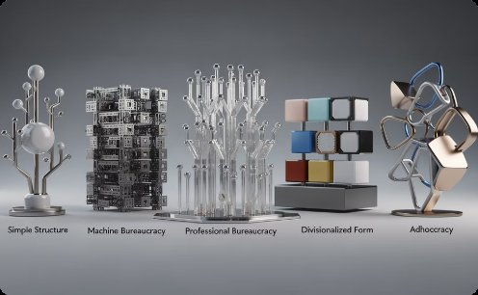
LEVEL 3 — ORGANISATIONAL
Organisational Structure & Design
Organisational structure defines how activities, roles, and authority are formally arranged within a firm. Structure shapes how information flows, how decisions are made, and how employees experience their work. The following three theoretical frameworks have shaped how we think about and design organisations.
📹 Video Placeholder — "Think about the difference between your school and a small family business, or between a hospital and a startup. Why does one feel rigid and rule-bound while the other feels chaotic and free? You've already experienced multiple organisational structures — your school has a hierarchy, your sports club has roles, your family has its own version of authority and division of labour. This video uses those familiar structures from your everyday life to explain Weber's bureaucracy, Taylor's scientific management, and Mintzberg's configurations — so that when you join an organisation, you'll immediately be able to read its structure and understand why it feels the way it does."
Weber's Bureaucracy Theory
Taylor's Scientific Management
Mintzberg's Organisational Configurations
Max Weber described the ideal-type bureaucracy as a rational, rule-governed organisation characterised by: formal hierarchy of authority, written rules and procedures, specialisation of labour, impersonality (decisions based on rules, not personal preference), and merit-based selection and promotion. While often criticised as rigid, Weber saw bureaucracy as the most technically efficient organisational form — and its legacy is visible in most large organisations today.
Frederick Winslow Taylor applied scientific principles to optimise work performance. His four principles: scientifically study each task to find the one best method; select and train workers scientifically; cooperate with workers to ensure methods are followed; and divide work between managers (planning) and workers (execution). Scientific Management drove industrial productivity but was criticised for dehumanising workers by treating them as interchangeable parts.
Henry Mintzberg proposed five structural configurations that emerge from different combinations of coordinating mechanisms and organisational components: Simple Structure (centralised, direct supervision), Machine Bureaucracy (standardised processes, large middle line), Professional Bureaucracy (skilled experts with autonomy), Divisionalised Form (autonomous divisions), and Adhocracy (flexible, project-based teams for innovation). Each suits specific environments and strategies.

Slide 15
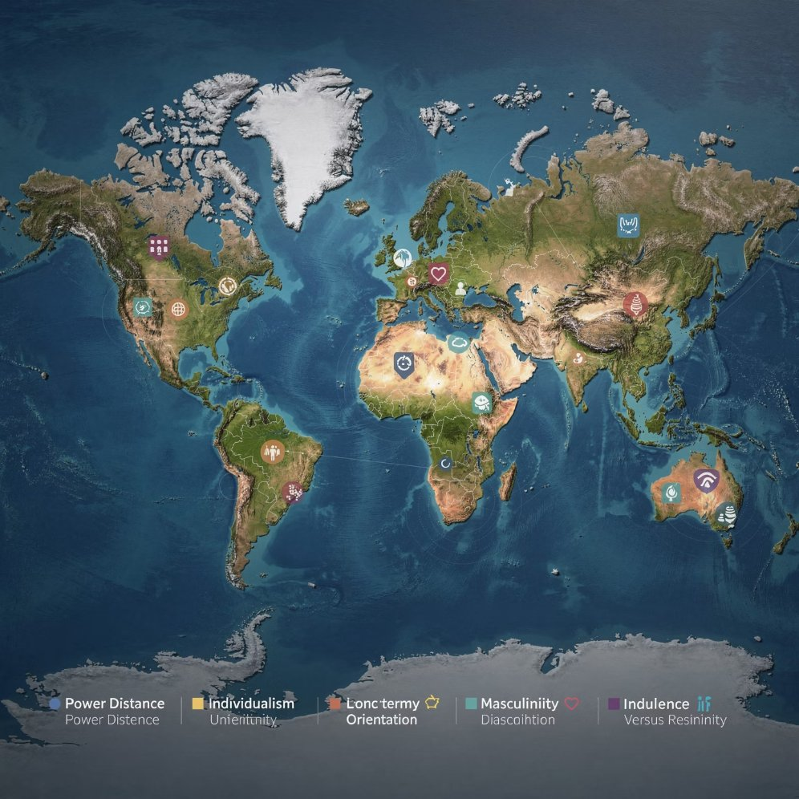
LEVEL 3 — ORGANISATIONAL
Organisational Culture
Organisational culture is the shared set of values, beliefs, and assumptions that define "how things are done around here." Culture is powerful precisely because much of it operates below conscious awareness — shaping decisions, behaviours, and relationships without explicit direction.
📹 Video Placeholder — "Every family has a culture. There are unwritten rules about what you talk about at dinner, how you handle disagreements, what's celebrated and what's never mentioned. Some families are loud and expressive; others are quiet and reserved. Some reward achievement; others prioritise loyalty. You didn't choose those rules — you absorbed them. That's Schein's three levels of culture: the visible rituals (artifacts), the stated values, and the deep assumptions nobody questions. And Hofstede's dimensions? They explain why your family's culture might feel completely normal to you but baffling to someone from a different background. This video uses family and community culture to make organisational culture theory feel like something you've been an expert in your whole life."
Schein's Three Levels of Culture
Edgar Schein proposed that organisational culture exists at three levels of visibility:
Artifacts
Espoused Values
The visible, tangible manifestations of culture — office layout, dress code, company rituals, logos, and the way meetings are run. Observable but hard to interpret without context.
The stated strategies, goals, and philosophies that the organisation publicly endorses — its mission statements, codes of conduct, and leadership rhetoric.
Basic Assumptions
The deeply embedded, unconscious beliefs that are taken for granted and rarely questioned. These are the true root of culture, and the hardest to change.
Hofstede's Cultural Dimensions
Geert Hofstede's landmark cross-national research identified six dimensions on which national cultures differ — profoundly affecting how organisations in those countries operate:
Power Distance — acceptance of unequal power distribution.
Individualism vs. Collectivism — loyalty to self/family vs. group.
Masculinity vs. Femininity — achievement and competition vs. care and quality of life.
Uncertainty Avoidance — tolerance for ambiguity and risk.
Long-term vs. Short-term Orientation — focus on future virtues vs. present traditions.
Indulgence vs. Restraint — degree to which impulses and desires are freely gratified.
These dimensions are essential for managing diverse, multinational teams and understanding why management practices that work in one culture may fail in another.

Slide 16






LEVEL 3 — ORGANISATIONAL
Management of Change
Organisational change is constant — driven by technology, competition, regulation, and evolving workforce expectations. The theories below offer managers structured frameworks for leading change effectively, minimising resistance, and sustaining new ways of working.
📹 Video Placeholder — "Think about a time something in your life changed and you resisted it — moving schools, a family restructure, a friendship group shifting, a new routine being forced on you. Why did you resist, even when the change might have been good? And think about a time change actually stuck — what made it different? Lewin's Unfreeze-Change-Refreeze, Kotter's 8 steps, and the ADKAR model aren't just for corporate transformations. They describe the exact psychological journey every human goes through when their world shifts. This video maps those personal moments of resistance, transition, and adaptation onto change management theory — so you understand change not as something that happens to organisations, but as something that happens to people."
Unfreeze
Change
Refreeze
Lewin: Disrupt the status quo. Create motivation to change by challenging existing assumptions and increasing the driving forces for change.
Lewin: Move to the new state. Provide direction, training, communication, and leadership to help people transition to new behaviours and systems.
Lewin: Stabilise the change. Embed new practices into culture, processes, and reward systems so they become the new normal.
Kotter's 8-Step Process
ADKAR Model (Prosci)
John Kotter's model provides a detailed roadmap for large-scale organisational transformation: (1) Create urgency; (2) Build a guiding coalition; (3) Form a strategic vision; (4) Enlist a volunteer army; (5) Enable action by removing barriers; (6) Generate short-term wins; (7) Sustain acceleration; (8) Institute change. Kotter emphasises that skipping steps or moving too quickly creates only the illusion of change without lasting impact.
ADKAR is a goal-oriented model focused on individual change, recognising that organisational change only happens when individuals change. Each letter represents a building block: Awareness (of the need to change), Desire (to support and participate), Knowledge (of how to change), Ability (to implement new skills and behaviours), and Reinforcement (to sustain the change). Gaps in any element explain why change initiatives stall.

Slide 17



LEVEL 3 — ORGANISATIONAL
Systems Theory
Systems Theory applies the principles of general systems thinking to organisations, viewing them as complex, dynamic, and interdependent entities rather than simple machines. This perspective fundamentally changed how managers think about cause, effect, and organisational health.
📹 Video Placeholder — "Have you ever noticed that when one person in your family is stressed, everyone else feels it? Or that fixing one problem in a group project somehow creates a new one somewhere else? That's systems thinking — and you've been experiencing it your whole life. Your family is a system. Your friend group is a system. Your school is a system. Change one part and the whole thing shifts. This video uses those interconnected relationships from your personal life to explain Open Systems Theory and General Systems principles — so that when you enter an organisation, you'll immediately understand why you can never change just one thing, and why the whole is always more than the sum of its parts."
Open Systems Theory (Katz & Kahn)
General Systems Theory Applied to Organisations
Daniel Katz and Robert Kahn applied open systems thinking to organisations, arguing that organisations are open systems that continuously interact with their environment. The organisation takes in inputs (people, materials, information, energy), processes them through internal transformation mechanisms (technology, culture, management), and produces outputs (products, services, waste). Crucially, the system relies on feedback loops from the environment to adapt and survive. Entropy — the tendency of systems to decay — is counteracted through negative entropy: importing more energy than is expended. This explains why organisations must continuously innovate and refresh their resources, culture, and strategies to avoid decline and obsolescence.
Ludwig von Bertalanffy's General Systems Theory provides the conceptual foundation. Key principles include: Holism — the whole is greater than the sum of its parts; Interdependence — a change in one subsystem affects all others; Equifinality — organisations can achieve the same outcome through multiple paths; and Synergy — effective integration creates performance beyond what individual parts could achieve. In practice, this means HR decisions affect operations, marketing affects culture, and leadership affects every other system simultaneously. Managers must think systemically, not in functional silos.

Slide 18

LEVEL 3 — ORGANISATIONAL
Work Stress & Well-being
Employee well-being is no longer a peripheral concern — it is a strategic priority. The theories below provide rigorous frameworks for understanding how work design, demand levels, and available resources shape employee health, performance, and retention.
📹 Video Placeholder — "Think about the difference between a subject you love — where the workload feels energising — and one you dread, where even a small task feels crushing. Or the difference between a family environment where you feel supported and one where you feel controlled. The pressure isn't always the problem. What's missing is often the control, the support, or the sense that it matters. That's Karasek's Demand-Control model and the JD-R framework — playing out in your study life, your home life, and your social life right now. This video uses those real personal experiences of stress, burnout, and flow to explain well-being theory — so you understand your own limits and resources before you ever have to manage someone else's."
Karasek's Demand–Control Model
Robert Karasek proposed that job stress emerges from the combination of high psychological demands and low decision latitude (control). His model produces four job types:
High Strain Jobs (high demands + low control): most stressful and harmful to health — associated with cardiovascular disease and burnout.
Active Jobs (high demands + high control): demanding but stimulating — promotes learning and motivation.
Passive Jobs (low demands + low control): lead to skill atrophy and disengagement.
Low Strain Jobs (low demands + high control): least stressful — promotes relaxation.
The model underscores that autonomy is a protective factor: giving employees control over how and when they work buffers the negative effects of high demands.
Job Demands–Resources (JD-R) Model
Arnold Bakker and Evangelia Demerouti extended Karasek's model into a broader framework applicable to any job. The model proposes two processes:
The Health Impairment Process: Excessive job demands (workload, emotional demands, role conflict) deplete energy and cognitive resources, leading to exhaustion and health problems when sustained over time.
The Motivational Process: Job resources (autonomy, feedback, social support, learning opportunities) fulfil psychological needs, fuelling engagement and performance.
Crucially, resources buffer the impact of demands: high demands are far less harmful when employees have access to strong resources. The JD-R model has become the dominant evidence-based framework for workplace well-being interventions, informing job redesign, leadership training, and organisational health strategies worldwide.

Slide 19





How to Use This Guide
This guide is built on a simple but powerful idea: you have already been living Organisational Behaviour your entire life. Every theory here plays out in your family, your friendships, your school, and your daily routines — long before it ever appears in a workplace. The videos and examples in this guide are designed to meet you where you are, so that theory becomes recognition, not memorisation.
Watch the Videos First — They Start With Your Life
Read With Your Own Life in Mind
Each theory section opens with a video that begins in your personal world — a family argument, a friendship dynamic, a group project, a daily habit — before connecting it to the organisational concept. Watch these first. They are not standard lecture videos. They are designed to make you say "oh, that's what that is" before you ever read the theory.
As you read each theory, ask yourself: "Where have I already seen this?" Think about your family structure (is it autocratic or collegial?), your friend group dynamics (who leads, who follows, who avoids conflict?), your own motivation patterns (what actually gets you moving?). OB is not abstract — it is a language for things you already experience.
Follow the Three Levels — They're Already in Your Life
Revisit After Real Moments
Individual theories describe you — your personality, your motivation, your perception. Group theories describe your friendships, family, and teams. Organisational theories describe the schools, clubs, and institutions you've grown up inside. You've been navigating all three levels your whole life. This guide just gives you the vocabulary.
Come back to a theory after a real experience — a falling-out with a friend (Conflict & Negotiation), a family decision that felt unfair (Equity Theory), a group that just clicked (Tuckman's Norming/Performing), a time you felt burnt out (JD-R Model). Theory becomes permanent when it's anchored to a memory.
💡 Study Tip: The most powerful exam answers don't just define a theory — they show it in action. Practice explaining each theory using a personal example first (family, friends, school), then translate it to an organisational context. This two-step approach builds deeper understanding and produces far more compelling written responses.

Slide 20
Quick Reference: All Theories at a Glance
Use this summary table as a revision tool and study companion. Each theory is mapped to its level of analysis, its author(s), and its core focus.
Level
Topic
Theory / Model
Core Idea
Individual
Motivation
Maslow's Hierarchy
Five-level pyramid of needs — lower needs must be met first
Individual
Motivation
Herzberg Two-Factor
Hygiene factors prevent dissatisfaction; motivators create satisfaction
Individual
Motivation
Vroom's Expectancy
Motivation = Expectancy × Instrumentality × Valence
Individual
Motivation
Adams' Equity Theory
People compare input/outcome ratios and act to restore fairness
Individual
Personality
Big Five (OCEAN)
Five stable trait dimensions predicting work behaviour
Individual
Perception
Attribution Theory
Internal vs. external causes of behaviour; fundamental attribution error
Individual
Learning
Bandura Social Learning
People learn by observing and modelling others
Individual
Ethics
Kohlberg's Moral Development
Three levels of moral reasoning: Pre-conventional → Conventional → Post-conventional
Individual
Ethics
Utilitarianism (Bentham & Mill)
Greatest good for the greatest number — outcomes-based moral reasoning
Individual
Ethics
Deontological Ethics (Kant)
Actions are intrinsically right/wrong; Categorical Imperative — treat people as ends, not means
Individual
Ethics
Stakeholder Theory (Freeman)
Organisations owe ethical obligations to all affected parties, not just shareholders
Individual
Ethics
Rest's Four-Component Model
Moral Sensitivity → Judgement → Motivation → Character: four steps to ethical action
Individual
Ethics
Ethical Climate Theory (Victor & Cullen)
Shared organisational perceptions of ethical norms shape individual moral behaviour
Group
Team Dynamics
Tuckman's Stages
Forming–Storming–Norming–Performing–Adjourning
Group
Leadership
Transformational
Leaders inspire change through vision, charisma, intellectual stimulation
Group
Leadership
Path-Goal Theory
Leaders adapt style to remove obstacles and motivate followers
Group
Power
French & Raven
Five bases of power: Legitimate, Reward, Coercive, Expert, Referent
Group
Conflict
Thomas-Kilmann TKI
Five conflict styles mapped on assertiveness and cooperativeness
Organisational
Structure
Weber's Bureaucracy
Rational, rule-governed hierarchy as most efficient organisational form
Organisational
Culture
Schein's Three Levels
Artifacts → Values → Basic Assumptions; deep culture is invisible
Organisational
Culture
Hofstede's Dimensions
Six cross-national cultural dimensions affecting management practice
Organisational
Change
Lewin's Three-Step
Unfreeze – Change – Refreeze: managing transitions systematically
Organisational
Change
Kotter's 8 Steps
Eight-stage roadmap for leading large-scale organisational transformation
Organisational
Well-being
JD-R Model
Demands impair health; resources fuel engagement and buffer demands

Slide 21

Keep Exploring Organisational Behaviour
Organisational Behaviour is a living, evolving field — but more than that, it is a lens for understanding human life. The theories in this guide are your foundation. But the most profound learning happens not in a textbook or a lecture hall — it happens when you recognise a theory in a conversation with your family, a falling-out with a friend, a moment of personal change, or a group that finally clicks. You have been living Organisational Behaviour your entire life. This guide just gives you the language to see it clearly.
🎓 For Students
💼 For Practitioners
📚 Go Deeper
Use this guide alongside your module textbook and lecture materials. Revisit sections before exams, and practise explaining each theory in your own words — this is the truest test of understanding. The Ethics section is especially important — it connects every other theory to the question of how we should act, not just how we do act.
Identify one theory per month and consciously apply it in your workplace — observe how your team forms (Tuckman), how motivation shifts (Herzberg), or how power operates (French & Raven). Reflection turns theory into wisdom.
Explore original sources: Maslow's Motivation and Personality, Schein's Organisational Culture and Leadership, Kotter's Leading Change, and Fisher & Ury's Getting to Yes. Primary texts reward careful reading with depth that no summary can replace.
✨ Remember: You don't need work experience to understand these theories. You need self-awareness. Every family is an organisation. Every friendship group has leadership, conflict, and culture. Every personal goal involves motivation, perception, and learning. The workplace is just one more arena where human behaviour plays out — and you've been studying human behaviour your whole life. Now you have the vocabulary to name what you've always known.

